Slide 1

User Generated Text Data
Abhilasha Kumar, Nadya Pramaputri, Harry Sharp
CP 8883 – Intro to Urban Analytics

Slide 2
Table of Contents
Definition
Application
How it works
Analysis methods and tools
Case studies
Twitter: sentiment analysis for vaccine
Analyzing user-generated content using natural language processing: a case study of public satisfaction with healthcare systems
FAQ

Slide 3
Definition
User Generated Text Analytics
The process of deriving high quality information from text.
User-generated text is any free-form text created by users such as online customer reviews, social media, conversational chat logs and forum posts.
The volume of this content has dramatically grown thanks to the booming of the Internet.
There are great challenges and opportunities on organizing, retrieving and mining these big data.

Slide 4
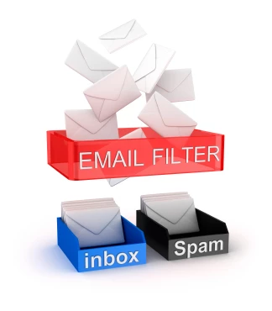
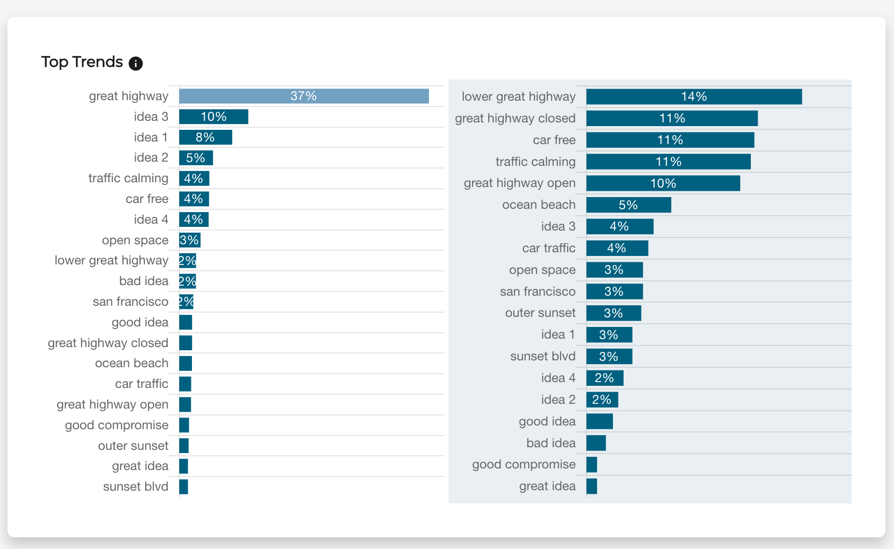


Applications
It is crucial for businesses such as news media, data analytics and policy makers to summarize, understand and extract meaningful information out of this sheer volume of data to make better decisions.
For instance, marketers need to explore and analyze customer reviews to understand customers’ interests, discover patterns, and gain deeper insights in order to invest in areas that leads to higher profits and user satisfaction.
Online textual content is different from traditional documents about its structure, vocabulary, length and semantics.
In addition, user-generated content are often temporally sequenced. For instance, social media posts, comments on discussion forums, and comments on content-sharing websites such as YouTube, are chronologically ordered.
Spam filter​
Review for a public service​
Customer review feedback​
Mental health chatbots

Slide 5
Text analysis tools
SaaS (Software as a Service) tools used:
Python
NLTK – Natural Language Toolkit
SpaCy – NLP library
Scikit-learn - machine learning toolkit for Python built on top of NumPy, SciPy, and matplotlib
TensorFlow – Google developed library for distributed deep learning
PyTorch – deep learning platform developed by Facebook
Caret – R package designed to build machine learning pipelines
Mlr – Machine learning in R – a machine learning toolkit frequently used for text analysis
Java
Source: https://monkeylearn.com/text-analysis/
Accessed through API so no skill needed to build analysis pipeline
Google Cloud NLP
IBM Watson
Lexalytics
Meaning Cloud
Amazon Comprehend
Aylien
Source: https://monkeylearn.com/text-analysis/

Slide 6
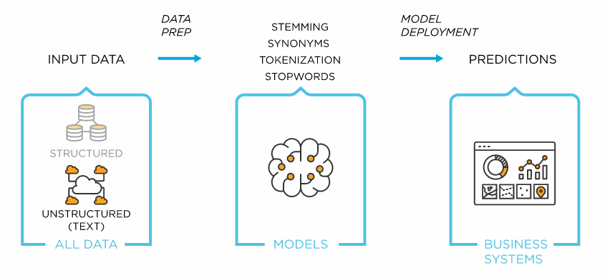
How it works
~20% of enterprise data (Gartner)
Census
GTFS, OSM​
Yelp
~80% of enterprise data (Gartner)
Urban images computer vision
Graph source: https://www.tibco.com/reference-center/what-is-text-analytics

Slide 7
Analysis Methods
Different sources of data gathering:
Internal Data
This is the data you generate every day, from emails and chats, to surveys, customer queries, and customer support tickets.
The data is exported as a CSV or Excel file or connect an API to retrieve it directly.
Some examples of internal data: Customer Service Software, CRM, Chats, Emails, Surveys, Databases etc
External Data
This is text data about your brand or products from all over the web. You can use web scraping tools, APIs, and open datasets to collect external data from social media, news reports, online reviews, forums, and more, and analyze it with machine learning models.
Some examples of external data: Web Scraping Tools, APIs, Integrations
Graph source: https://www.linkedin.com/pulse/pre-processing-text-nlp-vanessa-afolabi/, https://monkeylearn.com/text-analysis/
Notes:
Stemming and lemmatization both refer to the process of removing all of the affixes (i.e. suffixes, prefixes, etc.) attached to a word in order to keep its lexical base, also known as root or stem or its dictionary form or lemma. The main difference between these two processes is that stemming is usually based on rules that trim word beginnings and endings (and sometimes lead to somewhat weird results), whereas lemmatization makes use of dictionaries and a much more complex morphological analysis.

Slide 8
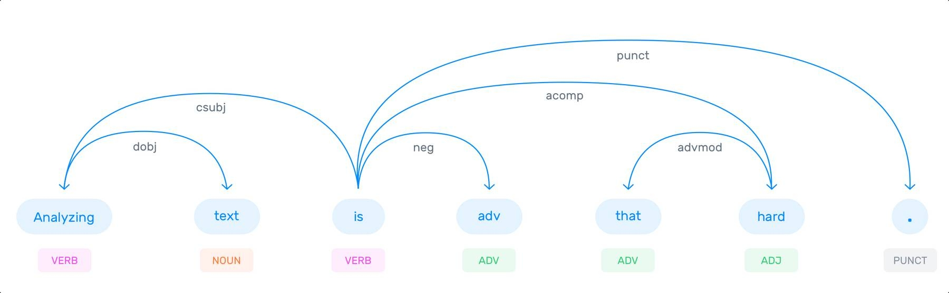
Analysis Methods
Tokenization: Process of breaking up a string of characters into meaningful parts & discarding meaningless chunks (e.g. space).
Part-of-speech tagging: Process of assigning a grammatical category, eg noun, verb, to the tokens that have been detected.
Parsing: Parsing is the process of converting formatted text into a data structure. A data structure type can be any suitable representation of the information engraved in the source text.
Analyzing text is not that hard
= [“Analyzing”, “text”, “is”, “not”, “that”, “hard”, “.”]
“Analyzing”: VERB, “text”: NOUN, “is”: VERB, “not”: ADV, “that”: ADV, “hard”: ADJ, “.”: PUNCT

Slide 9
Analysis Methods (2)
Text classification – the process of assigning predefined tags or categories to unstructured text
Sentiment analysis – automated reading and classifying for opinion polarity
Topic analysis – automatically organizing text by subject or theme
Intent detection – algorithms to understand the reason behind a message
Text extraction – extract pieces of data that already exist in the text
Keyword extraction – identifying most relevant terms in text
Word frequency – measuring the most frequently occurring words or concepts in text
Collocation – identifying words that occur together in pairs or triplets
Concordance – identifying the context and instances of words in text (KWIC)
Word sense disambiguation – differentiating words with more than one meaning
Clustering – grouping text into clusters around a set of similar words
Source: https://monkeylearn.com/text-analysis/

Slide 10
Case Study 1: Utilizes social media data to analyze the public’s perceptions towards vaccination
The study utilizes Twitter data (January 2015 – July 2021) to analyze the public perception towards vaccination.
Identifies three vaccine sentiments (pro, anti, neutral of vaccine)
Operates sentiment analysis by using Word Embedding and Machine Learning techniques
Chen, Q., & Crooks, A. (2022). Analyzing the vaccination debate in social media data Pre-and Post-COVID-19 pandemic. International Journal of Applied Earth Observation and Geoinformation, 110, 102783.

Slide 11
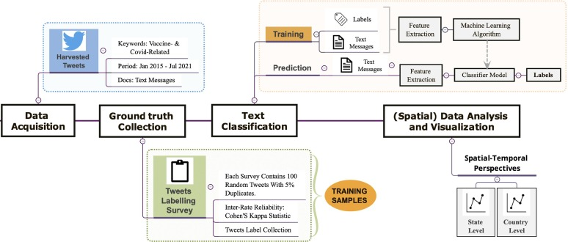
Notes:
introducing the Twitter dataset used in this study (Section 3.1), followed by hand-labeled tweets collection through the designed dynamic online labeling questionnaire (Section 3.2). Then we demonstrate an ensemble approach combining Word2Vec and machine learning techniques to develop a classifier for sentiment analysis (Section 3.3). The classifier was subsequently applied to identify the sentiment of unlabeled tweets. Lastly, in Section 3.4, we introduce a simple ratio between Anti and Pro-vaccine as a proxy to quantify vaccine hesitancy.

Slide 12
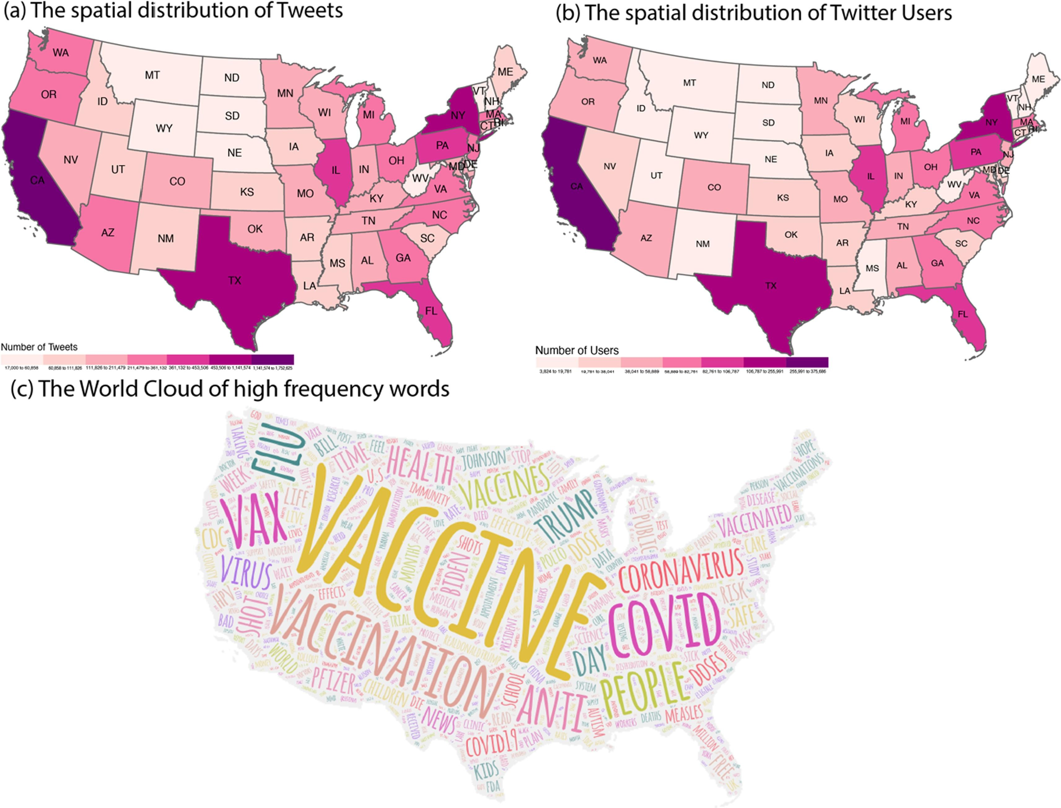
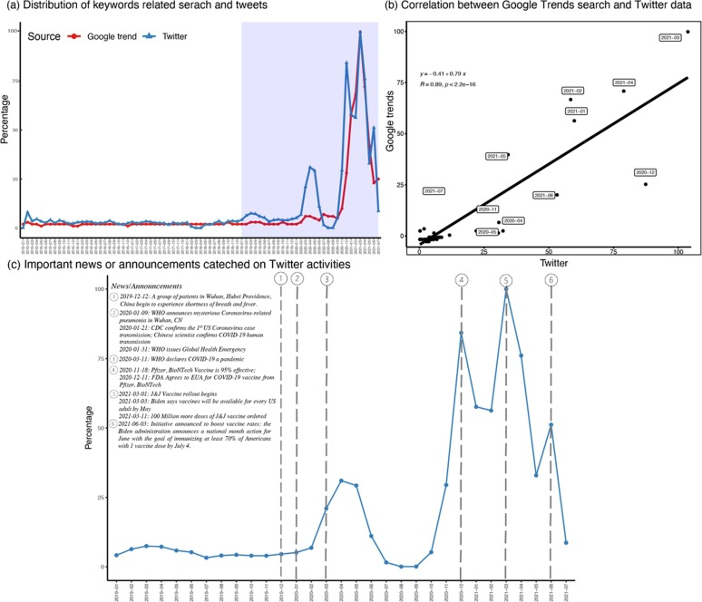
Data distribution

Slide 13
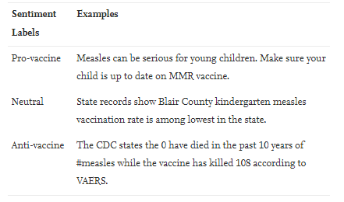
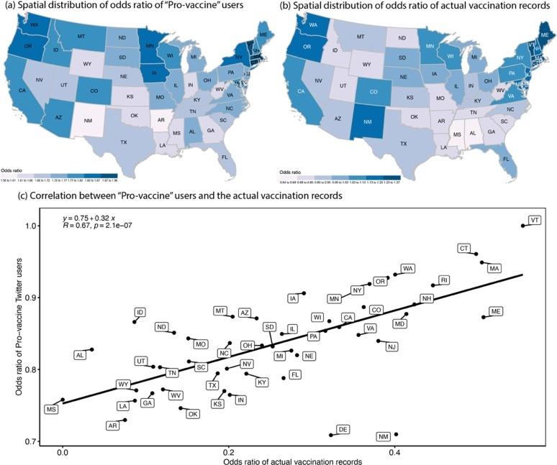
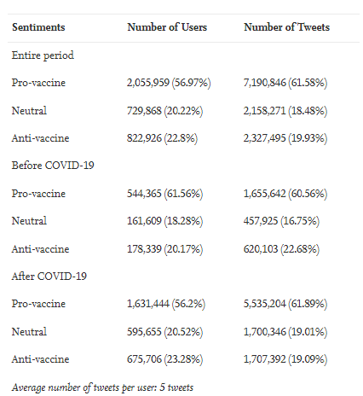
Notes:
A2P ratio: derived from the identified pro and anti vaccine sentiments with estimated vaccine hesitancy from cdc. By mapping the spatial distribution of both normalized A2P ratio and estimated vaccine hesitancy, we contextualized the findings in Fig. 7. We observed that relatively higher A2P ratios and estimated vaccine hesitancy are mostly entrenched in states in the West and South, such as Wyoming (WY), Arkansas(AR), Florida (FL), Louisiana (LA), Nevada (NV), and so on. Besides this, we also observed that WY stood out from the other states in both maps, appearing as the most vaccine-hesitant state in the country, which was consistent with the result in Douthit et al.’s (2015) study. An important reason may be the inequality in resources allocation and distribution. More specifically, these states have a high proportion of people living in more rural areas who have greater difficulties in seeking medical care

Slide 14
Case Study 2: Analyzing user-generated content using natural language processing: a case study of public satisfaction with healthcare systems
The study explores the potential of user-generated content and present an application of natural language pre-processing, text mining and sentiment analysis to the question of public satisfaction with healthcare systems.
Concretely, the study analyzed 634 online comments reflecting attitudes towards healthcare services in different countries.
The analysis identifies the frequency of topics related to healthcare services in textual content of the comments and attempts to classify and rank national healthcare systems based on the respondents' sentiment scores.

Slide 15
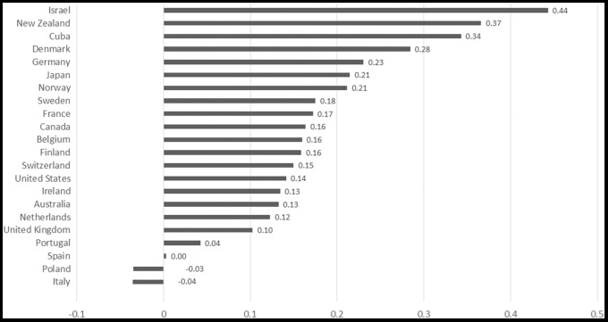
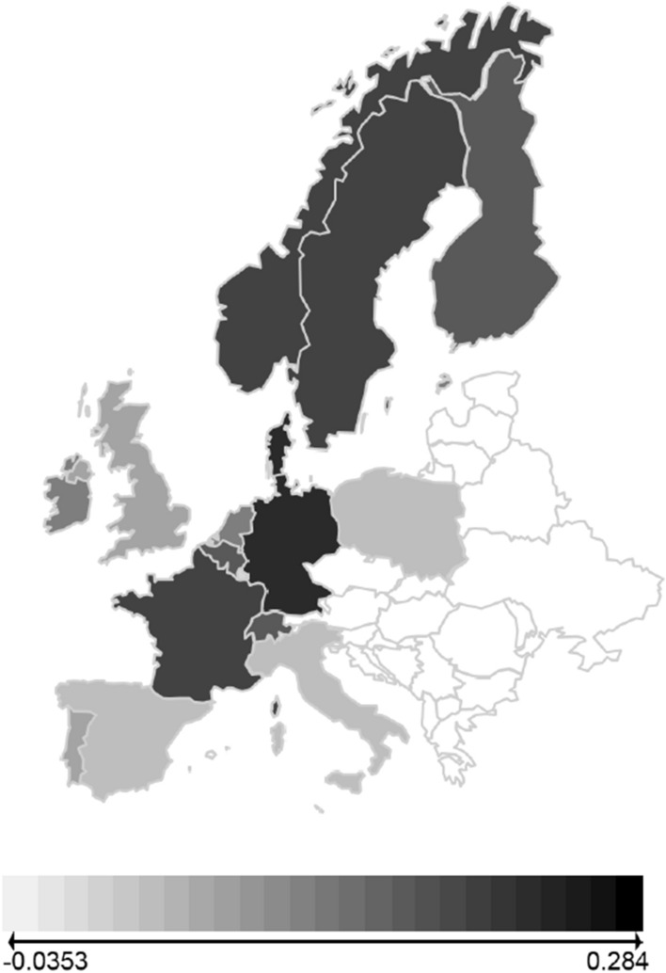
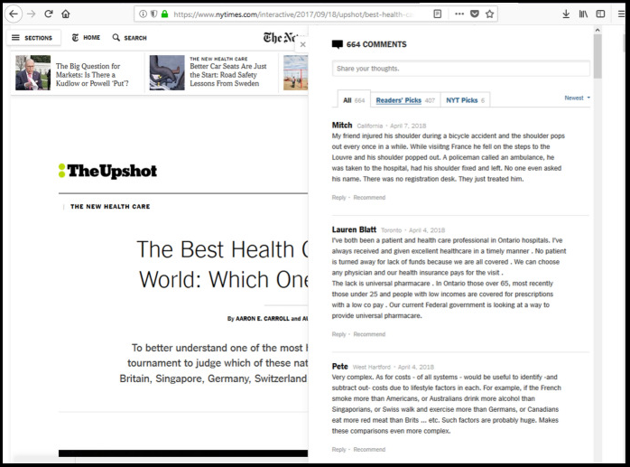
Data collection and Analysis
The analysis identifies the frequency of topics related to healthcare services in textual content of the comments and attempts to classify and rank national healthcare systems based on the respondents' sentiment scores.
This paper, describes the approach, summarizes the main findings, and compare them with the results from cross-national surveys. Finally, we outline the typical limitations inherent in the analysis of user-generated online content and suggest avenues for future research.
Continuous sentiment score at the country level
Screenshot of readers’ comments on nytimes.com
Retrieved from https://www.nytimes.com/interactive/2017/09/18/upshot/best-health-care-system-country-bracket.html
Sentiment scores across European countries

Slide 16

Thank you!

Slide 17
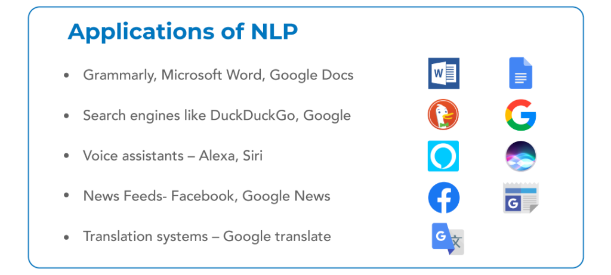
FAQs (if we have time)
Is text analytics the same as Natural Language Processing?
NLP and text mining differ in the goal for which they are used.
NLP is used to understand human language by analyzing text, speech, or grammatical syntax.
Text mining is used to extract information from unstructured and structured content. It focuses on structure rather than the meaning of content.
Text analytics = text mining?
They are largely synonymous, but the former has a more nuanced meaning. By transforming the data into a more structured format through text mining (getting the text) and text analysis (processing the text), more quantitative insights can be found through text analytics.
Reference: https://www.mygreatlearning.com/blog/top-nlp-projects/

